Slide 1
ECM Progress report
Katie Hoskins, Tanya Peacock, Marcus Stange

Slide 2
Big Changes
Database
Design/Requirements

Slide 3
Database changes
”Schools” table addition
Users given a “school_id”
“allowed_domains” table addition
RLS
”Events” table changes
date date and scheduledTime timetz

Slide 4
Design/requirement changes
Removed “Register” page
Added more to the appbar
Editable calendar component implementation
Dark mode switch

Slide 5
Completed work
Accounts Page
Home, Sign In, Contact Pages
Dashboard
Users Page
Appbar
Search Functions
Calls to Supabase

Slide 6
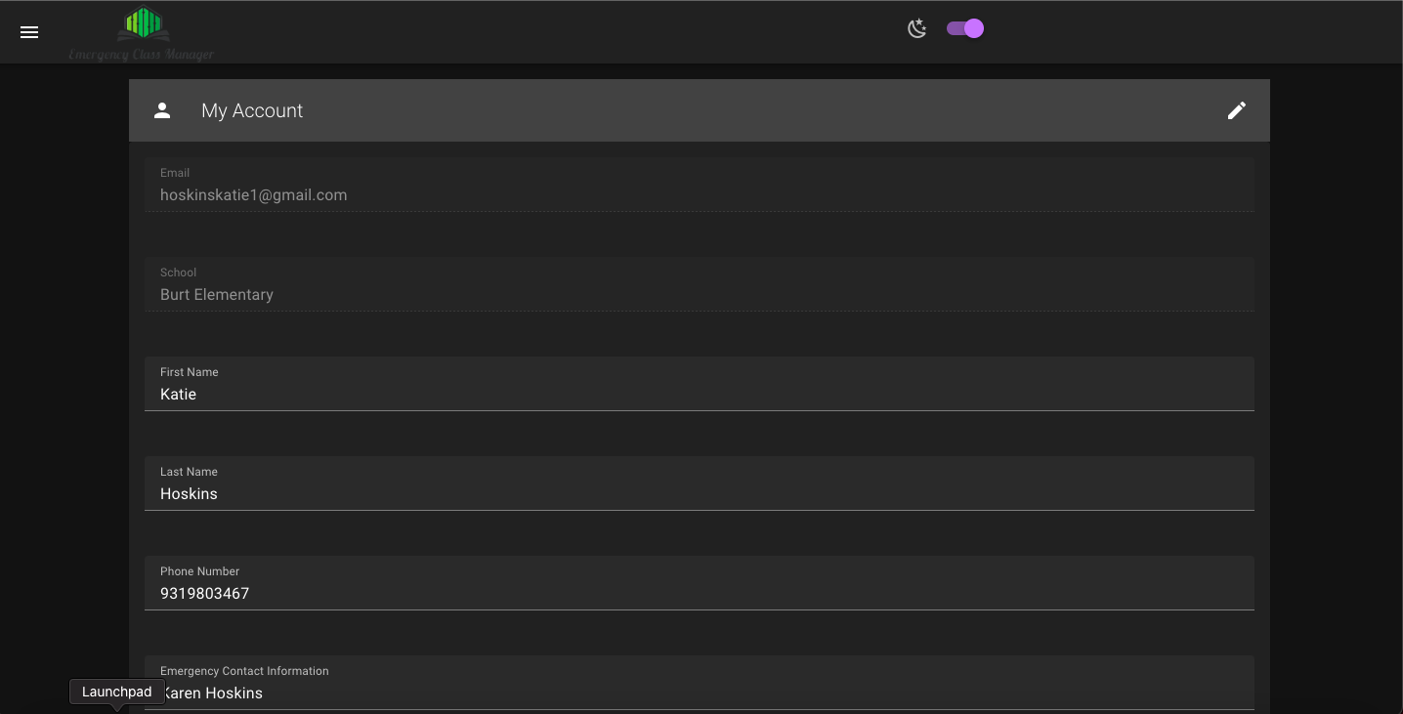
Completed work – accounts page

Slide 7
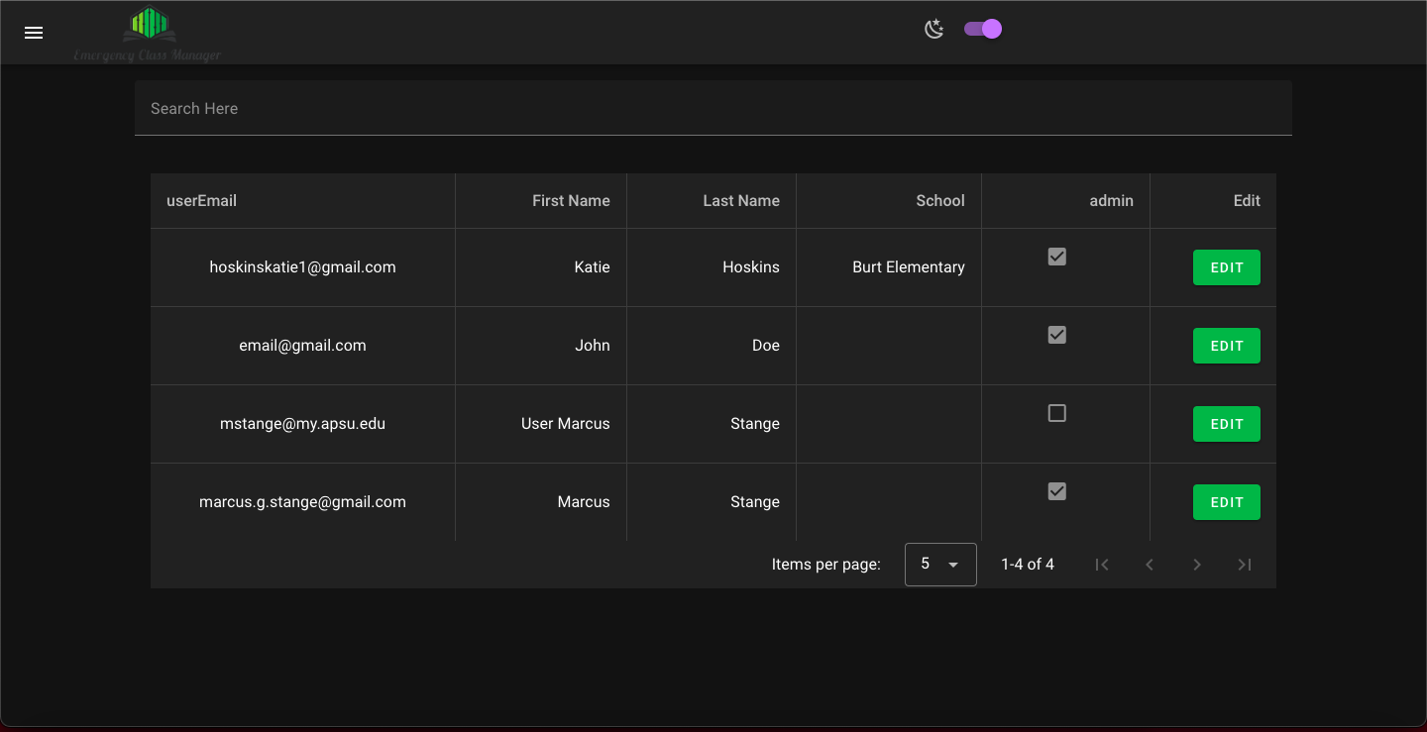
Completed work – Users page

Slide 8
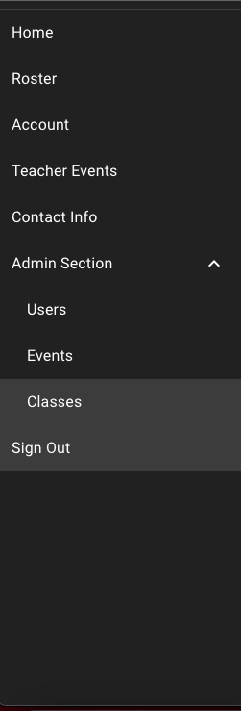
Completed work - appbar

Slide 9
WIP
Moving auth.users to public.users in Supabase
Inner Contact Page
Getting correct school information based on ”Users” and “Schools” table
Events Pages
Formatting times correctly
Roster Page
Classes Page
Getting the dropdown working with Supabase

Slide 10
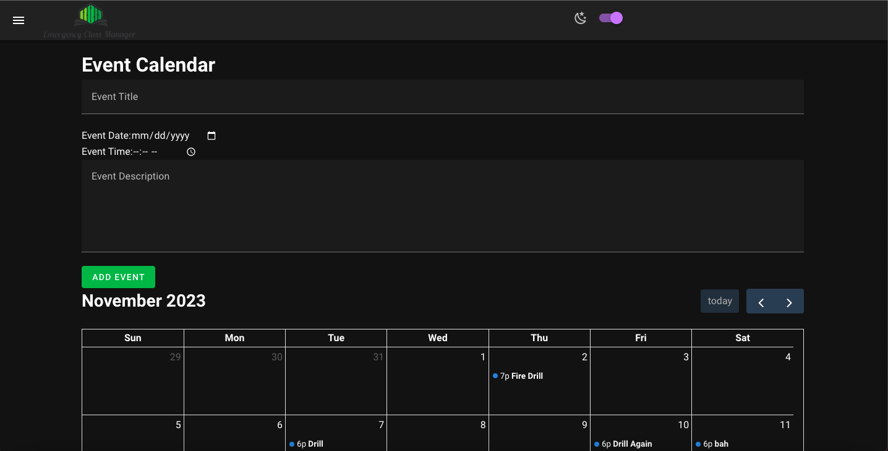
Wip – events page

Slide 11
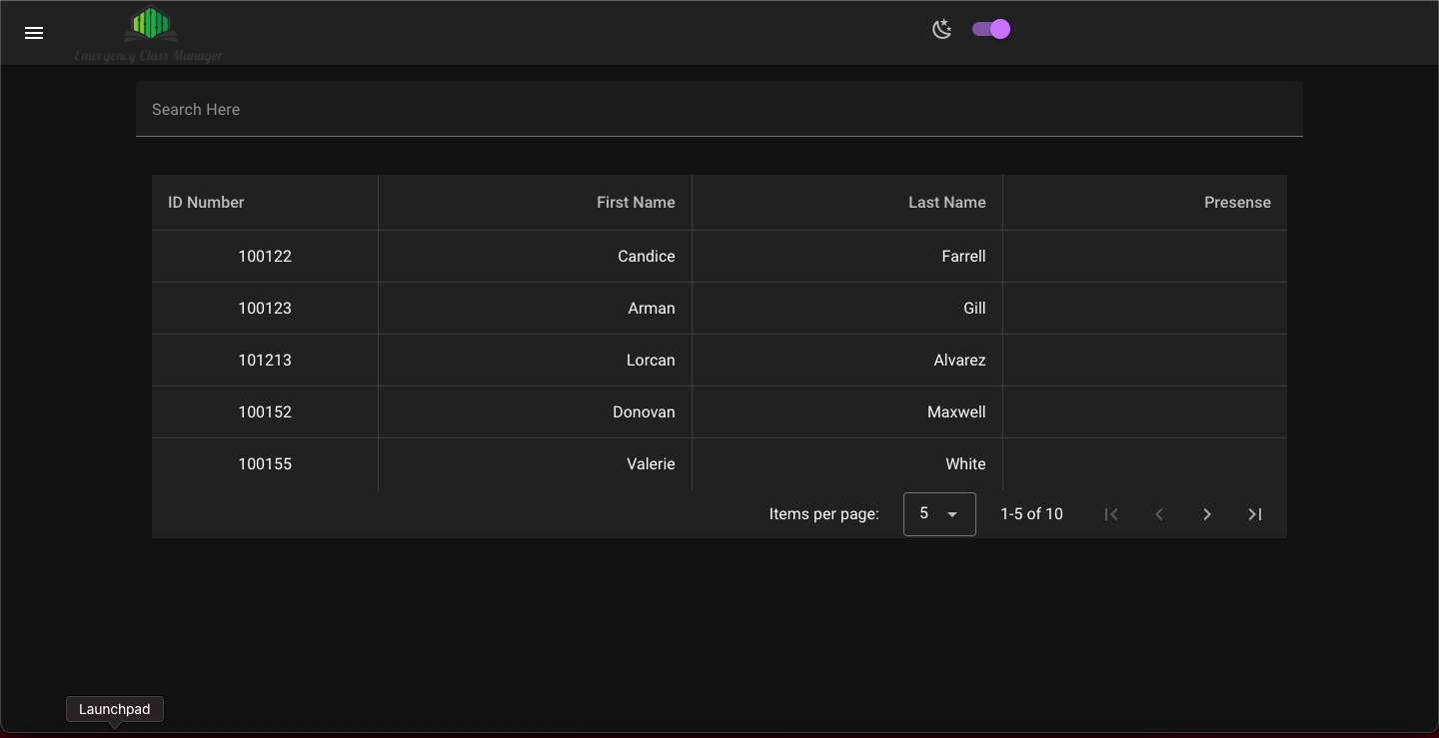
Wip – roster page

Slide 12
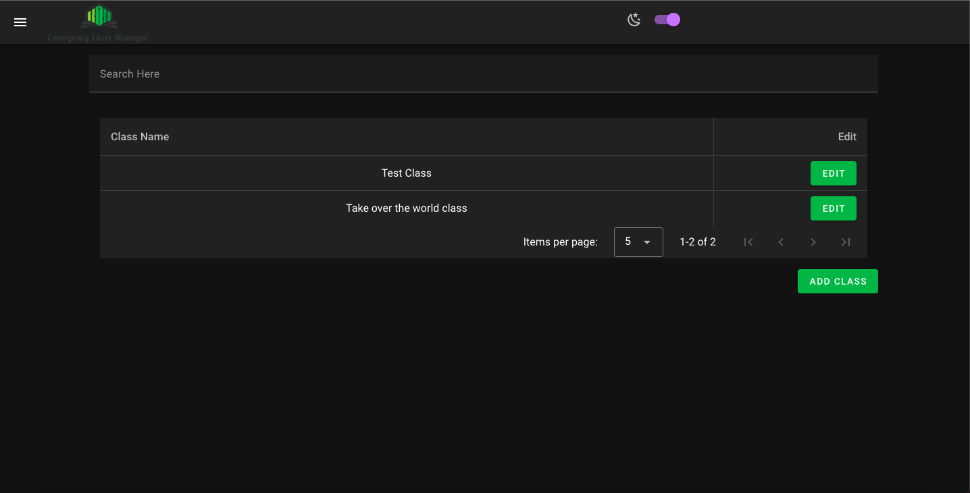
Wip – classes page

Slide 13
What is left?
Reports
Archives

Slide 14
Left – Reports
Will be easier to implement once we finish Roster page
Allow teachers to edit the Roster page
Need to submit the Roster page and send to administration

Slide 15
Left – Archives
Once Roster Page and Reports get done, this will be easily implemented
Need to save data for later usage
May need another table
Allow for read only access for admins

Slide 16
Biggest Issues
Translating event input to local/browser time
Using a trigger to copy auth.users into public.users table
Searching for students using name or ID number – SOLVED
Getting a user from a session – SOLVED
Using autocomplete while searching for students – SOLVED
Calendar Implementation - SOLVED

Slide 17
Questions?

